Slide 1
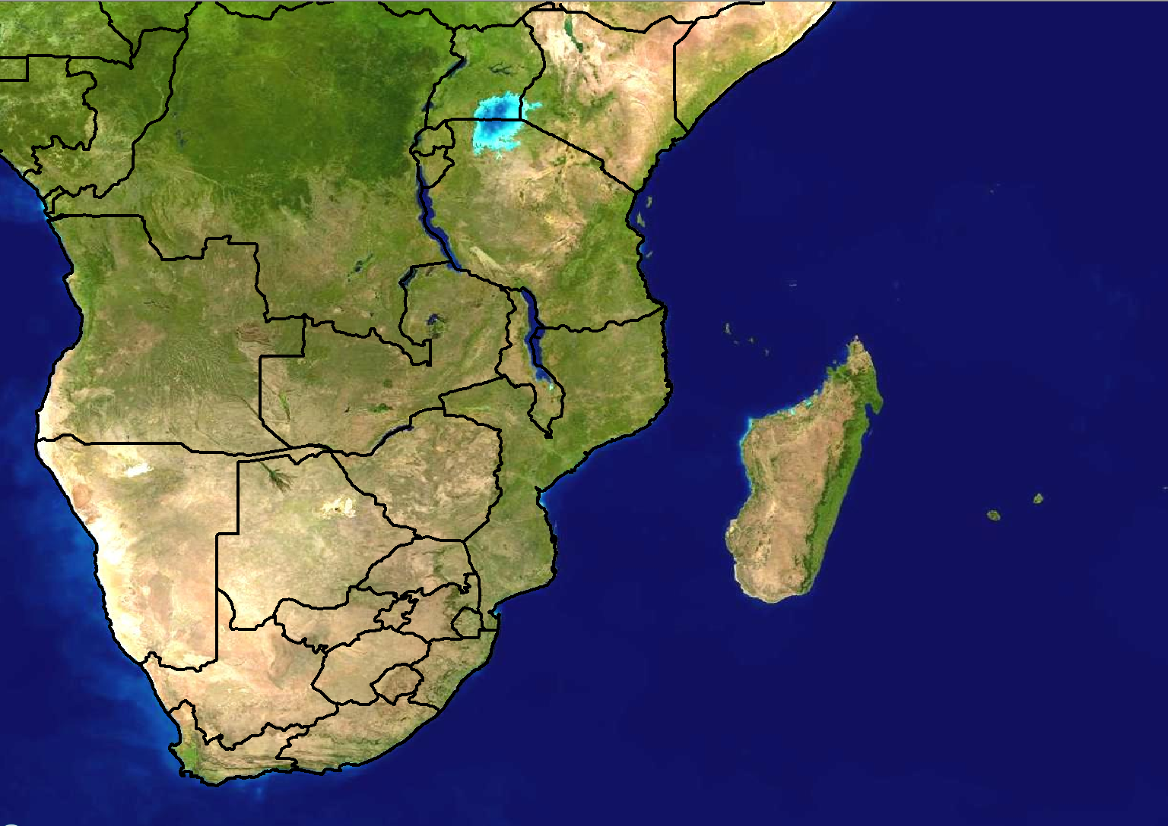
Scenario 1: Forecast for Day 3
24 hour rainfall (mm)
>100
80-100
60-80
40-60
20-40
Forecast issued:
Monday 20 February
Forecast valid:
Wednesday 23 February

Slide 2
Scenario 1 - Additional information:
There is a weak tropical low pressure that is expected to be situated just off the north-east coast of Madagascar on Wednesday
It does not seem to be very strong at this stage, possibly only reaching tropical depression stage
No forecast has been sent by RSMC La Reunion as yet, however NWP models are showing a large area of 60-80mm over the north-eastern parts of Madagascar in the next 24 hours, reaching 100mm in places.

Slide 3
Scenario 2: Forecast for Day 1 (Today)
24 hour rainfall (mm)
>100
80-100
60-80
40-60
20-40
Forecast issued:
Wednesday 23 February Forecast valid:
Wednesday 23 February

Slide 4
Scenario 2 - Additional information:
Tropical low pressure has weakened from what was expected and has moved position from what was originally expected
RSMC La Reunion sent a bulletin out yesterday and updated it today, classifying the low pressure as a tropical disturbance for today.
Models are in agreement with rainfall amounts of approx. 80-100mm in 24 hours
The Unified Model (12km) shows 6 hourly rainfall amounts of >50mm between 12-18Z over the extreme north-eastern parts of Madagascar today while Aladin shows 30-40mm during the same period.
The Department of Tourism has just contacted the weather office and said that there is a race that is scheduled to take place this evening at 18Z at Antsiranana (Diego Suarez) where 1000 international spectators are expected to watch the event

